Slide 1
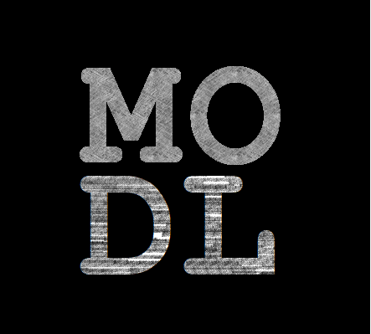
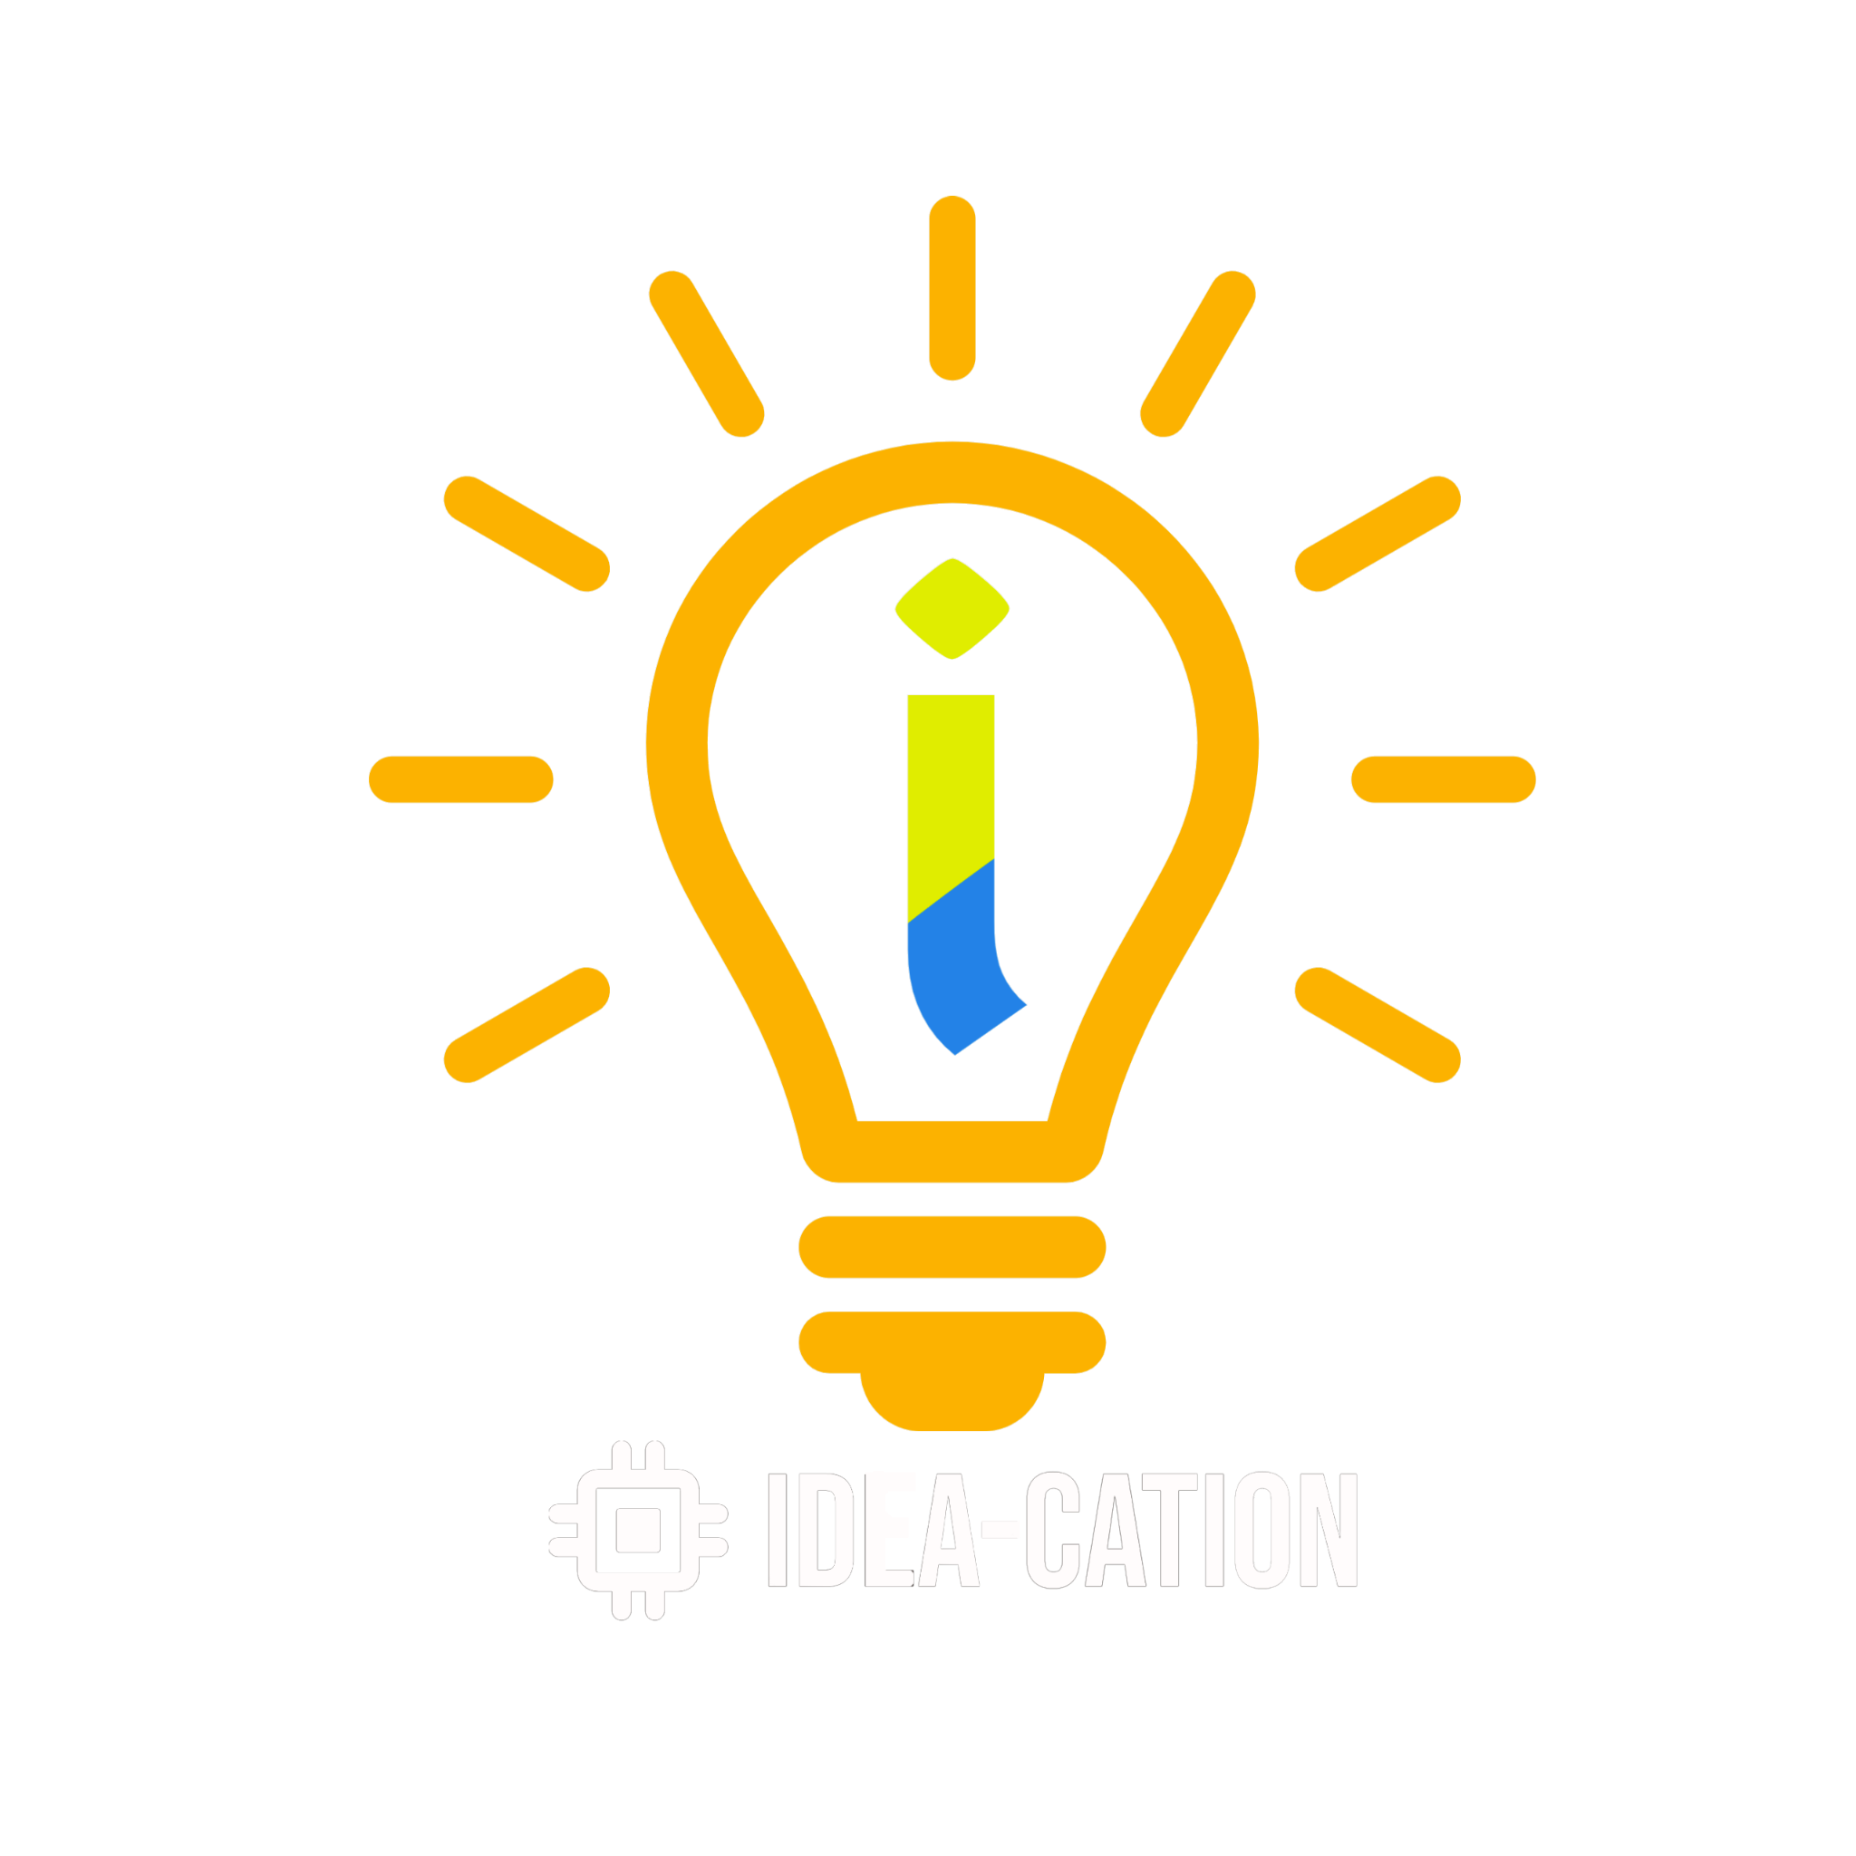

Macau Data Science
Meetup
Saturday April 23rd 2:30pm-4:30pm
Introduction to R
What is R, Why?
Try swirl
Data Ingestion
Data Wrangling
Visualization
IFTM ideation Lab
Avenida Padre Tomás Pereira Taipa

Slide 2
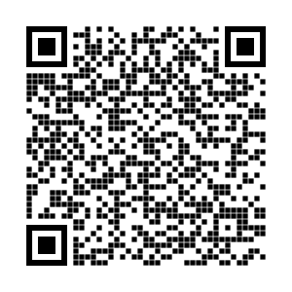
Introduction to R
Adam Zheng

Slide 3
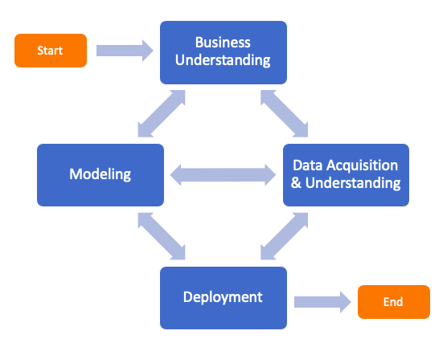
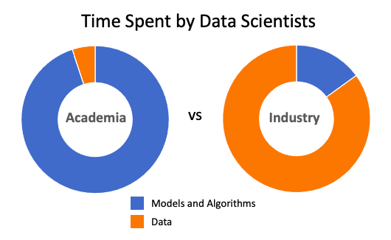
Business Science
TDS Source: Why I wasn’t prepared for my first Data Science job
Notes:
Data scientists spend 80% of their time cleaning data rather than creating insights.
OR Data scientists only spend 20% of their time creating insights, the rest wrangling data.
Every data science project would eventually became to a powerpoint slide…

Slide 4



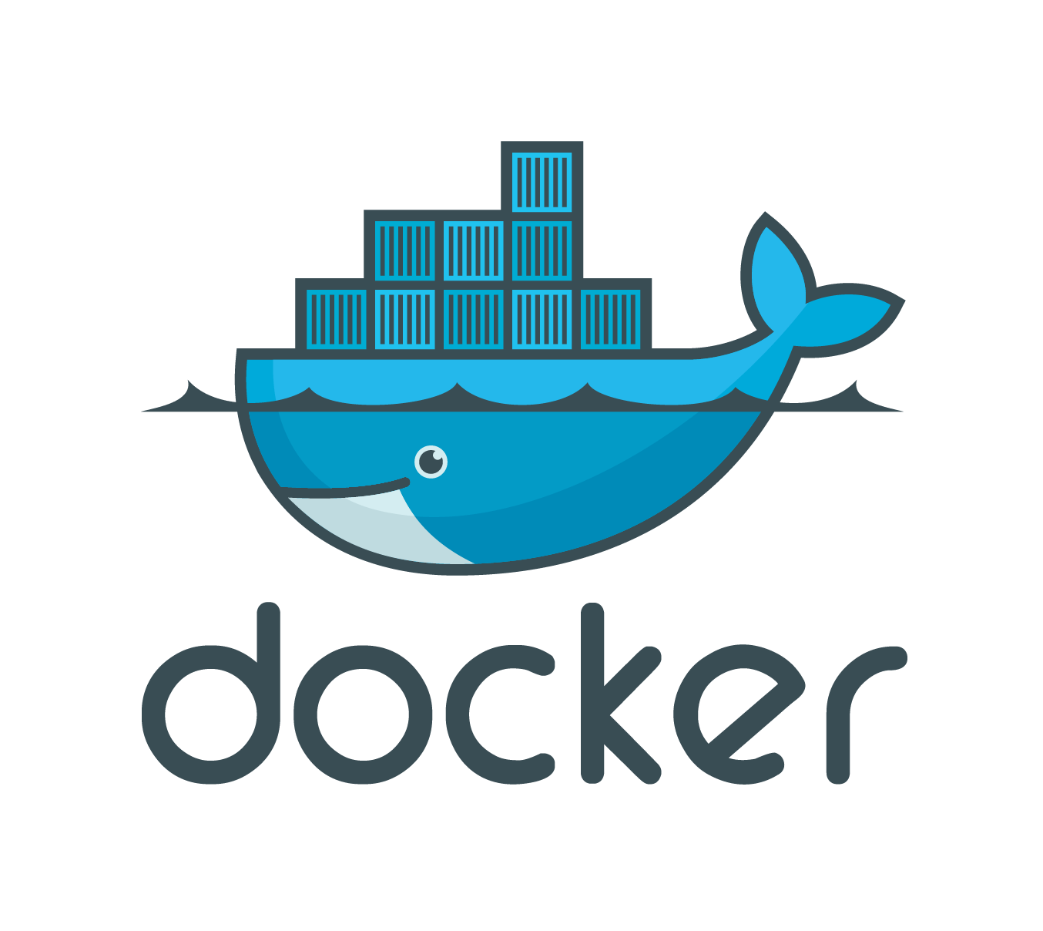
Lab Environment - rstudio.cloud

Slide 5
Storytelling
S was created around 1976
object-oriented programming designed for statistical analysis
R was created by 2 authors whose first name begins with R
Combination of S and the lexical scope of Scheme
Free and open source, first released by 1995, stable beta by 2000.
CRAN (Comprehensive R Archive Network) was setup by 1997
Originally had 3 mirrors and 12 contributed packages
By 2022, it has 101 mirrors and 18,728 contributed packages

Slide 6
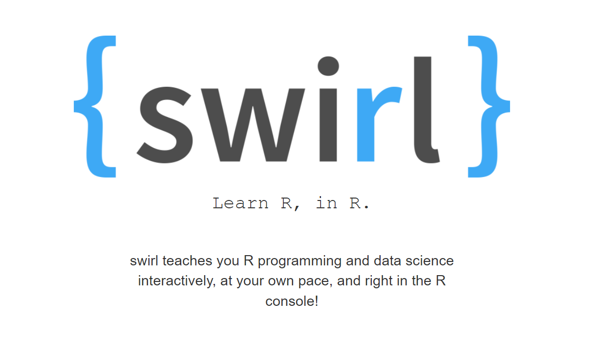
Course - swirlstats.com
install.packages("swirl")
library(swirl)
install_course_github("swirldev", "R_Programming_E")
swirl()

Slide 7
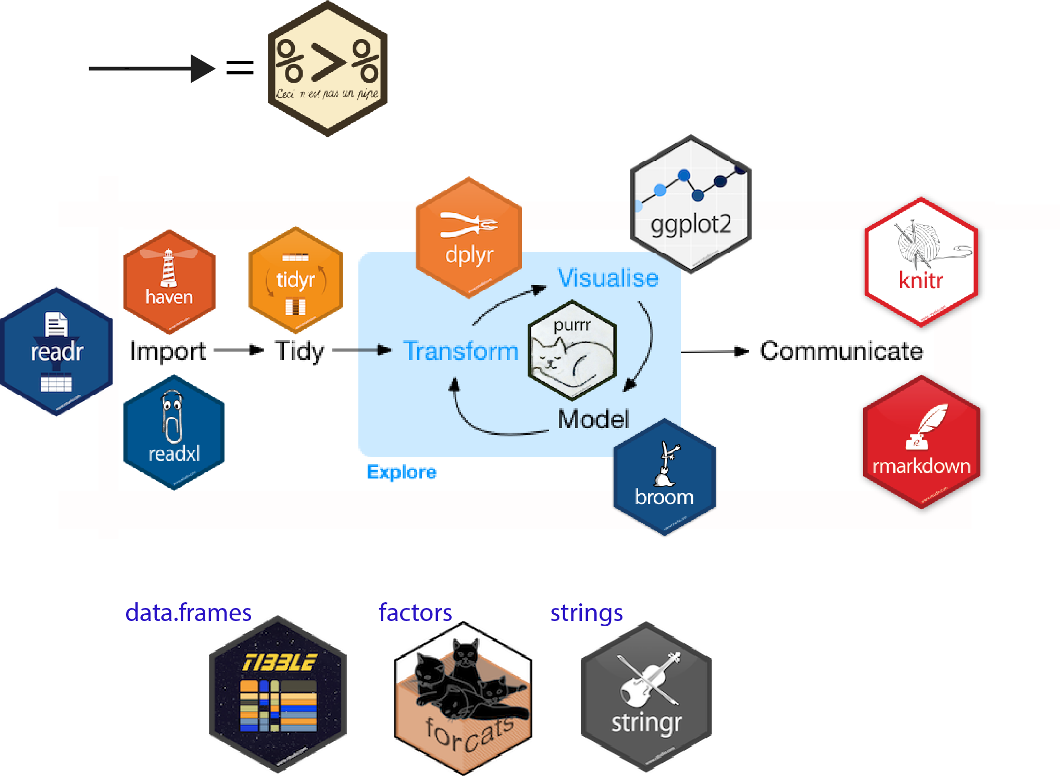
Tidyverse - a collection of R
ggplot2 - visualising stuff
dplyr, tidyr - data manipulation
purrr - advanced programming
readr - import data
tibble - improved data.frame format
forcats - working w/ factors
stringr - working w/ chain of characters
Source: Introduction to tidyverse (How to be a tidy data scientist)

Slide 8
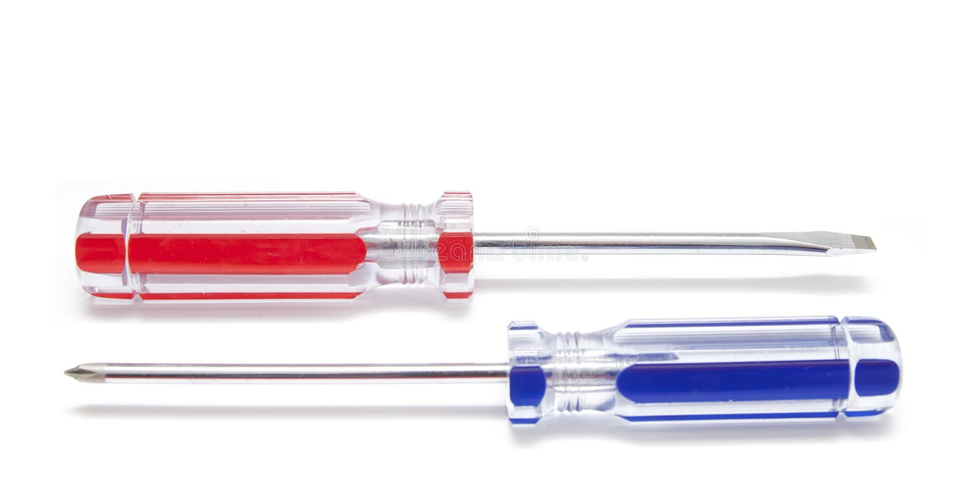
Myths about R vs. Python
Myth: Cognitive overload for Data Scientists
Fact: Data scientists can easily combine R and Python
Myth: Blockers to collaboration, reuse and sharing
Fact: Optimize team’s impact, not the language they use
Myth: Unnecessary burden on IT Infrastructure
Fact: Common infrastructure can support multiple languages

